Slide 1

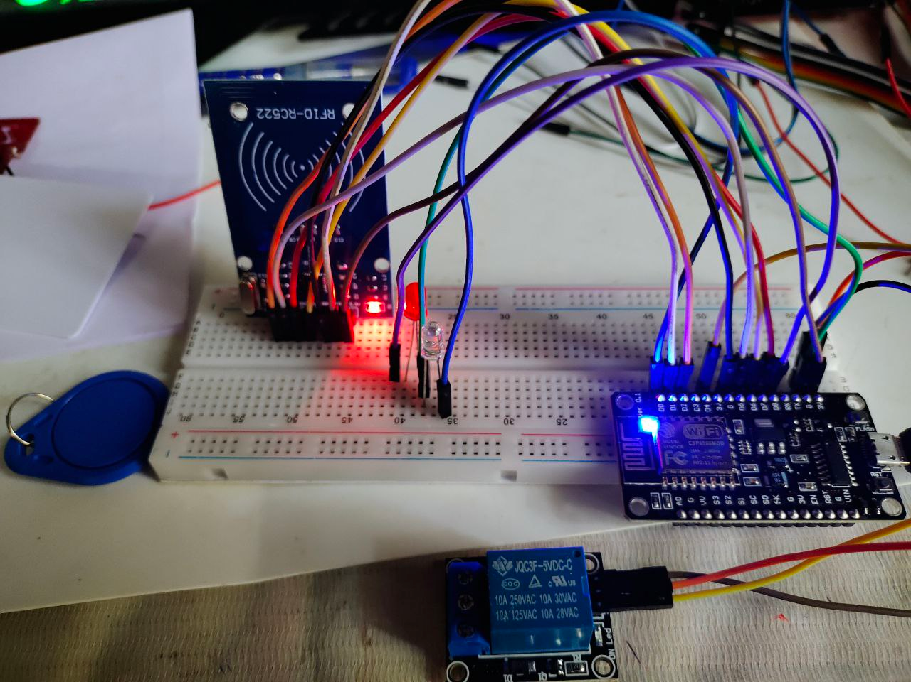
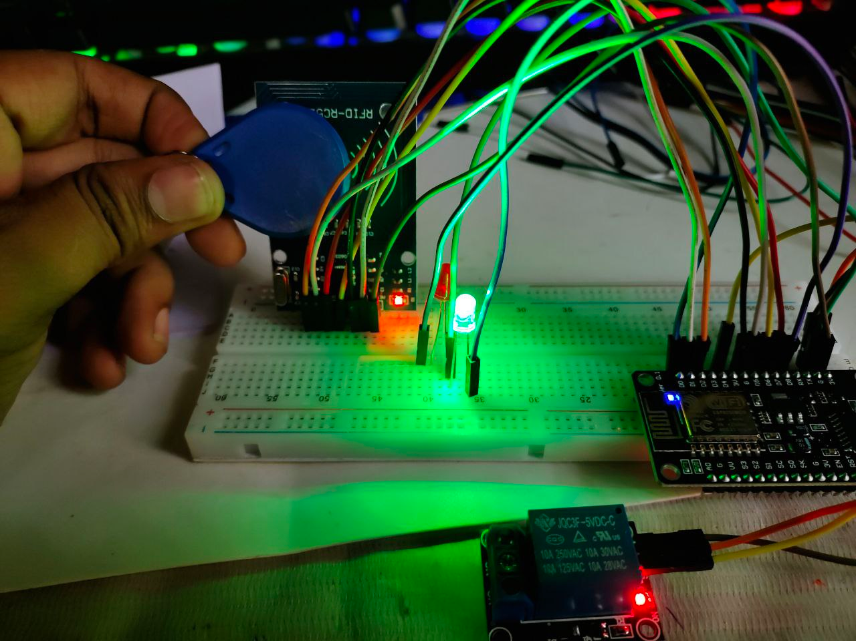
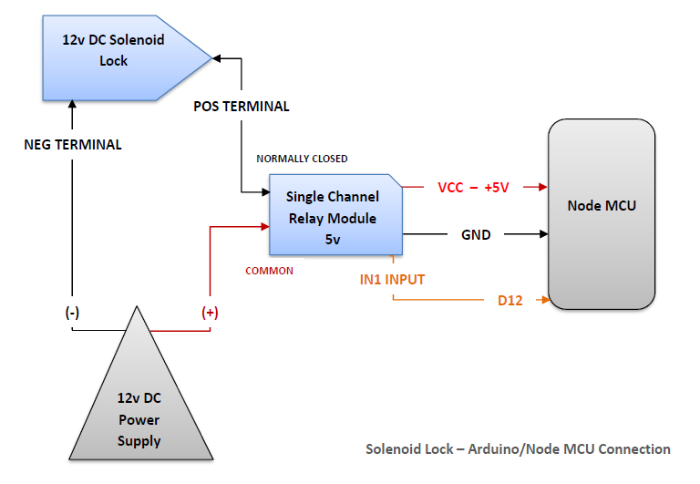
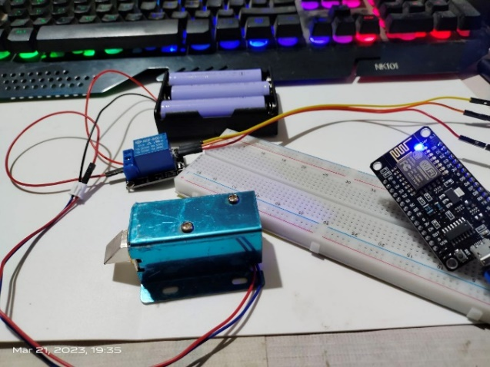
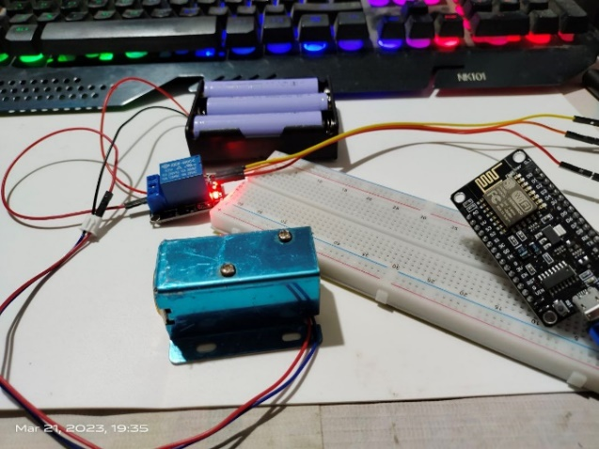
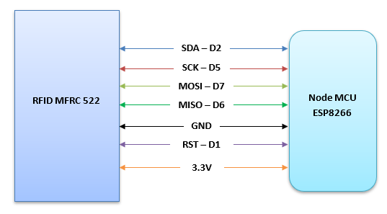
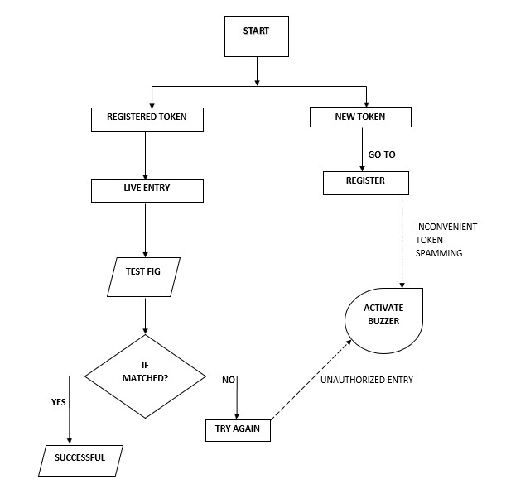
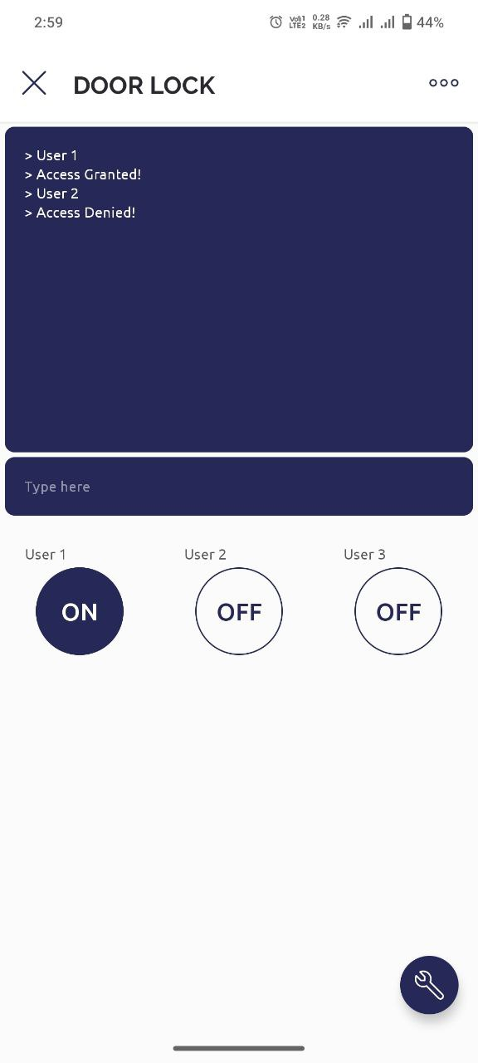
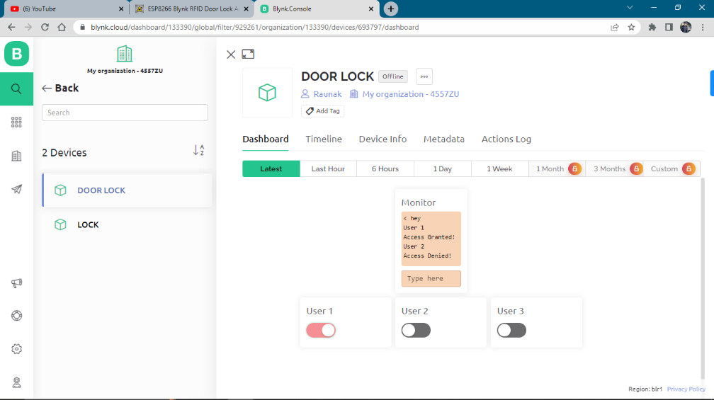
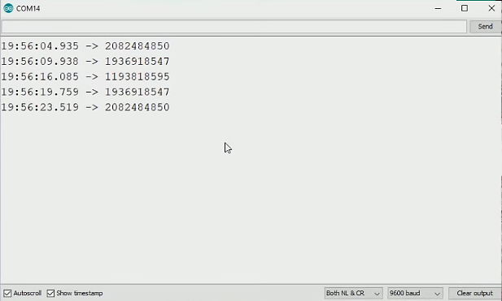
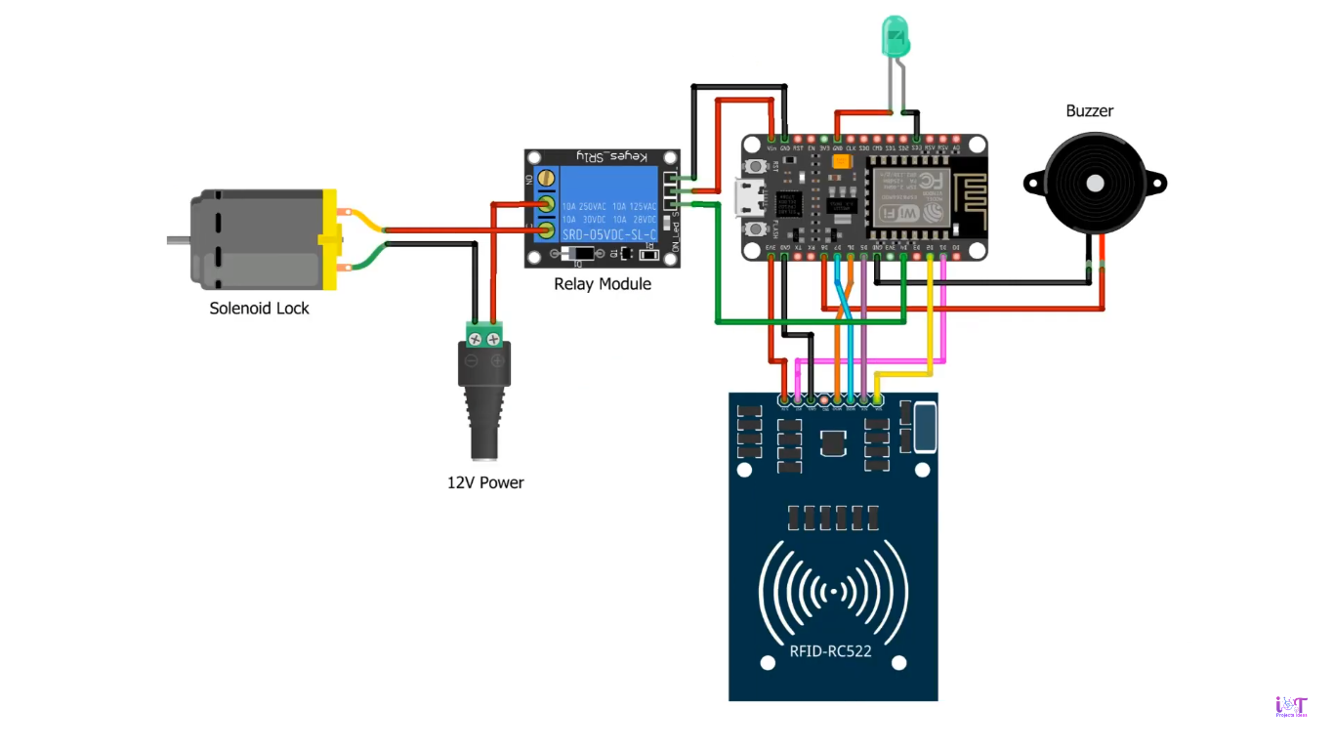
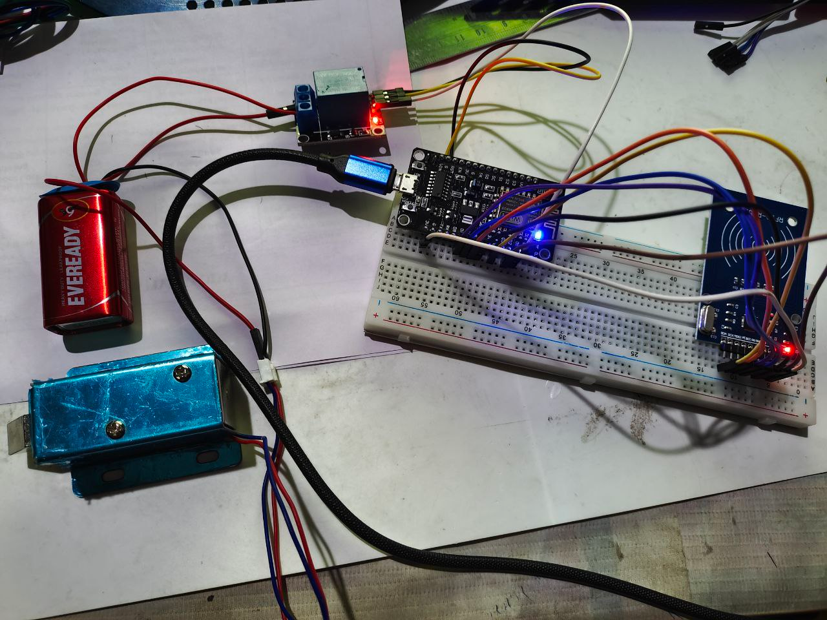
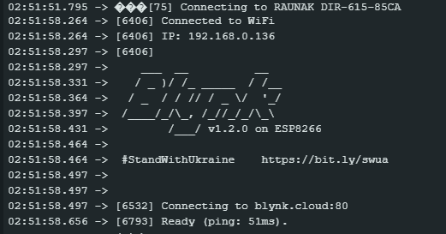



IoT based RFID Smart Door Lock System
Submitted By: RAUNAK MALLICK
Roll: 10071021038 Reg. No: 211000571010038
Supervised By: DR. JADAV CHANDRA DAS
INTRODUCTION
ALGORITHM
RESULTS
SYSTEM DESIGN
Abstract:
This project is intended for construction of a Smart RFID based Door Lock System, by using RFID Card module attendance scanner. The project based on the Node MCU is used for the desired purpose. A standalone module is a machine which can automatically perform tasks. 12C OLED Display Module set in front of the gate and shows the data about who is check-in with a proper ID. The RFID sensor detects the finger ID and give access to the 12V Solenoid lock to open the door.
The project also includes Blynk IoT app which provides the remotely controlled accessed for the whole project using Wi-Fi connectivity.
Why IoT based Smart Door Security System is needed?
Increased security, a fully wireless system, automated facial recognition, voice user interface, 24/7 monitoring, alerts on unusual or suspicious behavior, and a self-operating system are all requirements for IoT-based door security systems.
We are able to do this thanks to the internet of things (IoT), which gives users comfort and security. The door is the only barrier separating us from the outside world, thus protecting our homes with the appropriate security is crucial.
The suggested system is made to assist someone in protecting their home from theft; if a door is broken or a wrong password is entered, it immediately notifies the home's owner. A door lock system based on facial recognition is utilized to get around this problem.
Circuit Diagram:
Part 1: Starting the prototype model
Powering up Node MCU ESP8266
Connection build-up with all other modules and Blynk application.
Part 2: Registering token/card ID
RFID MFRC 522 module start up
Scanning token/card ID
Data storing in to the Node MCU EEPROM
Part 3: Restart the Process
Scanning the registered card/token ID
Live entry/checking the test figure
If card ID matched then successful, access the door
If not matched then try again. Otherwise if unauthorized token spamming then activate the buzzer.
Access Denied!
Figure: Card Authentication using RFID module
Access Granted!
Figure: Solenoid Lock connections with Node MCU
LOCKED
Figure: Solenoid lock connectivity with Relay
UNLOCKED
Figure: RFID MFRC 522 connection with Node MCU
CONCLUSION
In conclusion, internet of things (IoT)-based smart door lock solutions give users comfort and security. To guarantee security for both authorized users and visitor users, the suggested system uses the Internet of Things to build the digital lock system.
A digital password is used by the smart door lock system to unlock and close the door. The development of smart door locks is aided by the use of cloud computing for data storage. In order to provide a solution for secure entrance into an area while retaining a user record, our technique uses RFID technology.
Figure: Blynk Application Mobile & Web Dashboard results
Figure: Full Connection
BIBLIOGRAPHY
Figure: Card UID outputs in Serial Monitor
SMART DOOR LOCK, ISOEVA-2022: 6th INTERNATIONAL SYMPOSIUM OF EDUCATION AND VALUES.
International Journal for Scientific Research & Development (IJSRD): Intrusion Detection System for Smart Home using Internet of Things – Govinda K, Sai Krishna Prasad K and Sai Ram Susheel.
IIOP Conf. Series: Materials Science and Engineering 263: Home Security System using Internet of Things – Anitha A, VIT Vellore.
Smart Door Locking System Using IoT—A Security for Railway Engine Pilots: K. Sujatha, N. P. G. Bhavani, U. Jayalatsumi, T. Kavitha, B. Latha, A. Ganesan & A. Kalaivani
Figure: Blynk authentication with Node MCU output

